Slide 1
Introduction to AI – Unsupervised Learning
Philip Mortimer

Slide 2
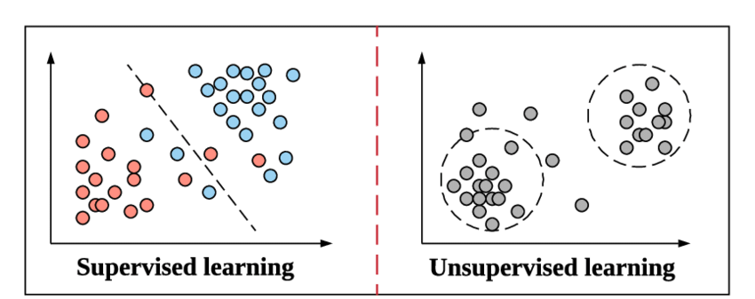

Slide 3
Recap
Reinforced knowledge of supervised learning by building an ANN to identify cancerous tumours
Discussed a modern variant of neural networks, CNN’s
CNN’s use feature extraction to learn high level details
This allows AI systems to be scaled for large inputs (e.g. high quality images)
We discussed TensorFlow, a popular machine learning library
Used TensorFlow to implement CNN and ANN to tackle handwritten digit recognition. We used MNIST dataset

Slide 4
Unsupervised Learning
Supervised learning involves labelled datasets. These labels often have to be produced by people
As machine learning requires large amounts of data to be effective, it is often very expensive to label the data required
This makes supervised learning challenging and costly to implement
It also means that the strength of a model is limited by the accuracy of the labels
This makes AI prone to human error and bias

Slide 5
Unsupervised Learning
Therefore, it is often much more appropriate to use unlabelled data
This is often more cost effective
There are also a wide range of systems were labelling data is simply inappropriate
For example, me way have a social media website with a large number of users
We may want to make an AI that recommends content that they are likely to find interesting
We as outside observers have no efficient way to label these users interests (we don’t know what that person actually likes)
However, a computer might be able to look at content that similar people like, and deduce that the user is likely to enjoy similar content

Slide 6
Unsupervised Learning
With supervised learning, there are a number of different algorithms to use (with gradient descent simply being the most common one)
Unsupervised learning is a bucket term that encapsulates a range of possible algorithms
Arguably the most popular one is k-means clustering

Slide 7
K-Means Clustering
The idea behind K-means clustering is that we have a set of datapoints and we went to group these data points into k clusters.
The idea is that each of these clusters should represent similar datapoints
The programmer species the number of different clusters that the data should be broken into (i.e. the value of k)

Slide 8
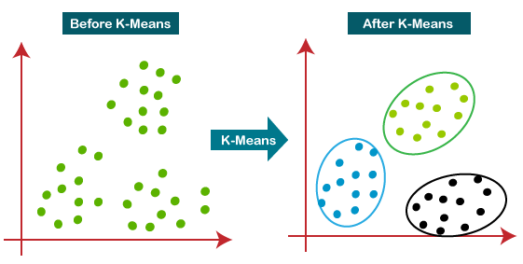

Slide 9
Algorithm
We select k random points to be the initial “centroids” of each cluster
We assign all points to one of these clusters by choosing the closest centroid for each point
Now we can recompute the centroid of the cluster by aggregating the distance of all points
We repeat this process with the newly calculated centroid
This process occurs until the centroids no longer change (or until a specified number of iterations has passed)

Slide 10
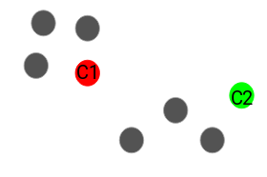
K-Means
STEP 1 – Choose K random centroids
In this case, k = 2
Credit: https://www.analyticsvidhya.com/blog/2019/08/comprehensive-guide-k-means-clustering/

Slide 11
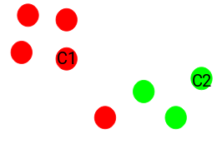
K-Means
STEP 2 – Assign all points to one of the k clusters based on which centroid they are closest to
Credit: https://www.analyticsvidhya.com/blog/2019/08/comprehensive-guide-k-means-clustering/

Slide 12
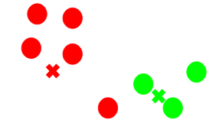
K-Means
STEP 3 – Calculate new centroids by taking that the aggregate location of the points within each cluster
Credit: https://www.analyticsvidhya.com/blog/2019/08/comprehensive-guide-k-means-clustering/

Slide 13
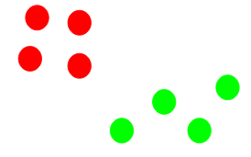
K-Means
Repeat Steps 2 and 3 until :
The recalculated centroids are the same as the current centroids
A fixed number of iterations has passed(i.e., we’ve spent enough time computing the solution)
All points remain in same cluster over multiple iterations
This gives us our clusters
Credit: https://www.analyticsvidhya.com/blog/2019/08/comprehensive-guide-k-means-clustering/

Slide 14
K-Means
K-Means enables us to group unlabelled data into categories that share common traits
K-means essentially draws k hyperspheres which have the same dimensionality as the number of datapoint attributes used
This has a very large number of practical applications

Slide 15
K-Means
Imagine we are a bank with 5 million customers
Let’s say we wish to give each customer an offer to acquire a credit card
Clearly, different customers will want different things from a credit card
We can’t sit down and decide what offer to make to each customer individually
Hence, we could make 3 different offer packages targeted at different customers
We may want one package to target people based on income. So we could split our packages into three classes: “high income, medium income, low income”
Using records of our customers, we may decide to cluster them based on the following attributes: “amount in bank, value of outstanding loans and bank balance five years ago”
This gives us a three dimensional space of five million datapoints

Slide 16
K-Means
We then run the k means algorithm using k = 3 to cluster our data
We know have 5 million customers neatly divided and can target out offers accordingly
Note of course, that k means tells us nothing about what each cluster actually means. We need some way of figuring this out ourselves
This could be achieved by human verification, our smart algorithms

Slide 17
K-Means
In many cases, we won’t know what value of k is most suitable
A method known as the “elbow method” is often used. It involves choosing the value of k at which the distance between points in the cluster stops decreasing quickly

Slide 18
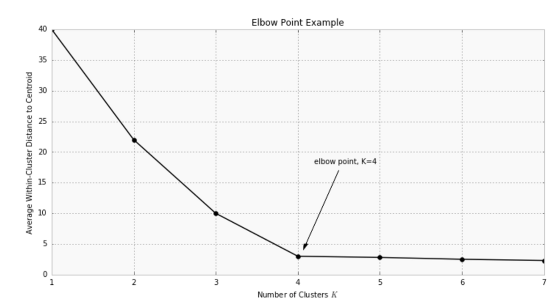
Elbow Method
We can see that at k = 4, the average distance within a cluster stops decreasing as rapidly
At this points, the points have been grouped effectively
We don’t want k to be too large, as more groups often means more unneeded complexity

Slide 20
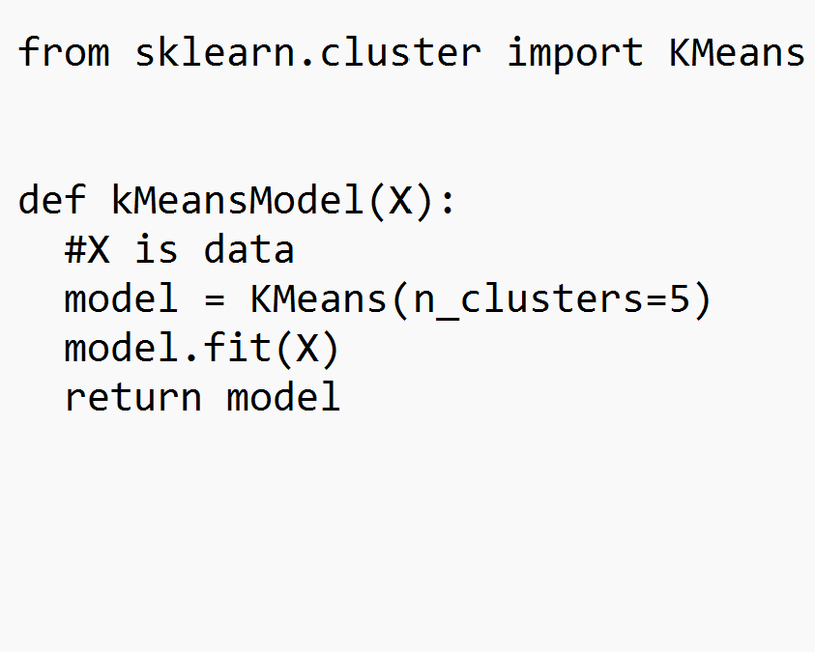
K-Means
Many algorithms have already been written and tested by other programmers. We can simply reuse these if we wish (which saves us developing from scratch).

Slide 21
K-Means
I’ve coded my own k-means learning model that clusters data into groups
Let’s look at the code. The code can be found here: https://github.com/philipmortimer/AI-Course/blob/main/Programs/Part%206/kMeans/main.py

Slide 22
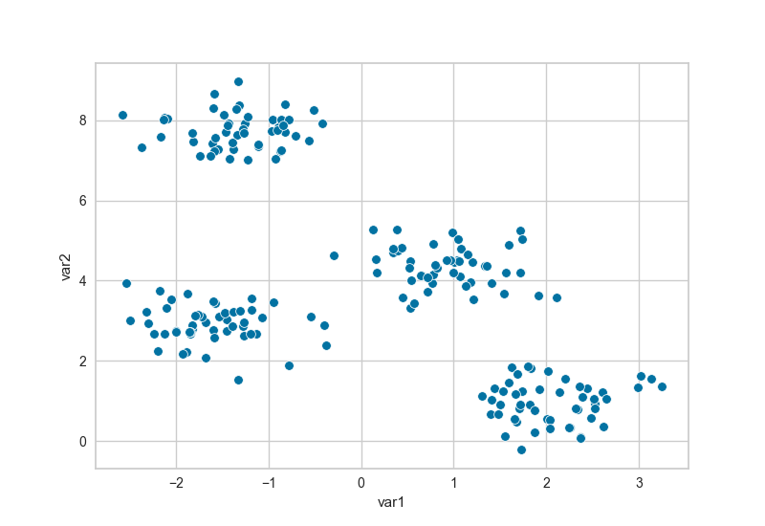
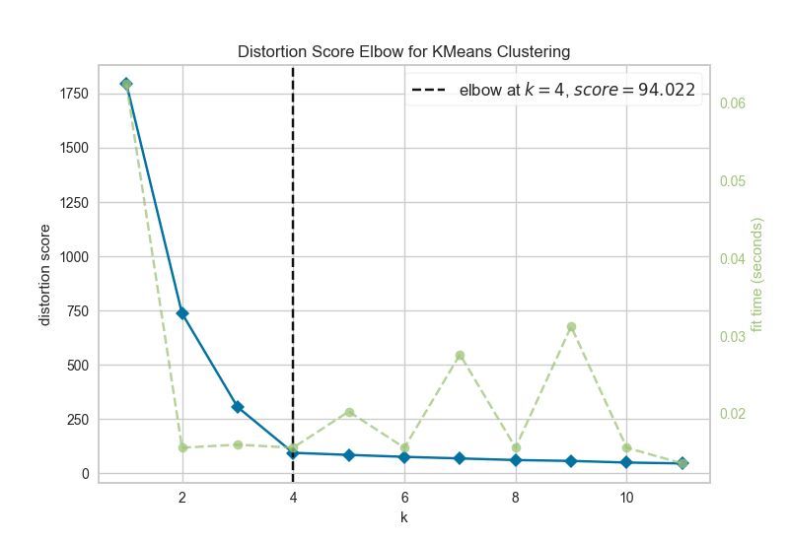
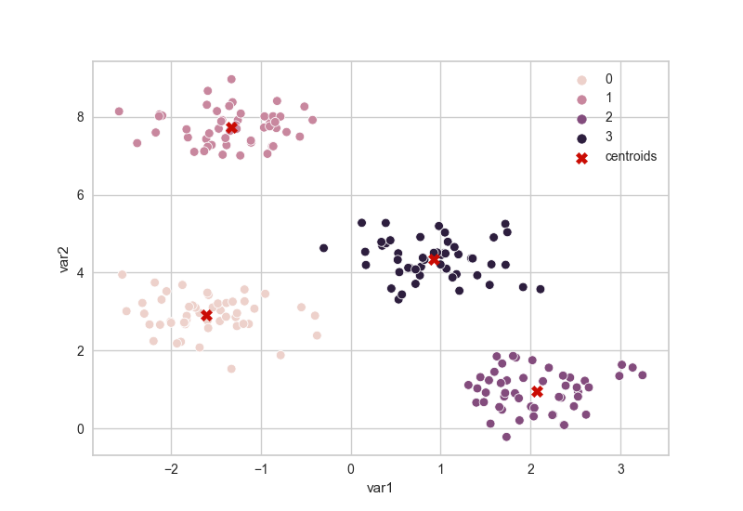

Slide 23
Auto-Encoders
Unsupervised learning covers a wide range of techniques and algorithms
Image compression often uses a neural network structure known as an autoencoder
These networks compress images by reducing their dimensionality by extracting the key features
Auto-encoders are often trained on specific image types (e.g. only images of cats) in order to make them more effective at dimensionality reduction

Slide 24
Auto-Encoders
Auto-encoders require an unlabelled dataset (e.g. of images)
We use supervised learning techniques to train the network (i.e. gradient descent)
We have two networks, namely an “encoder” and a “decoder”
The encoder network converts the image into an abstract representation that uses less data than the original image
The decoder converts the compressed format into the original image
By combining the two components, we have a network that can use data both as input and as a label
Sometimes the input image is blurred slightly to add “noise” to the input

Slide 25
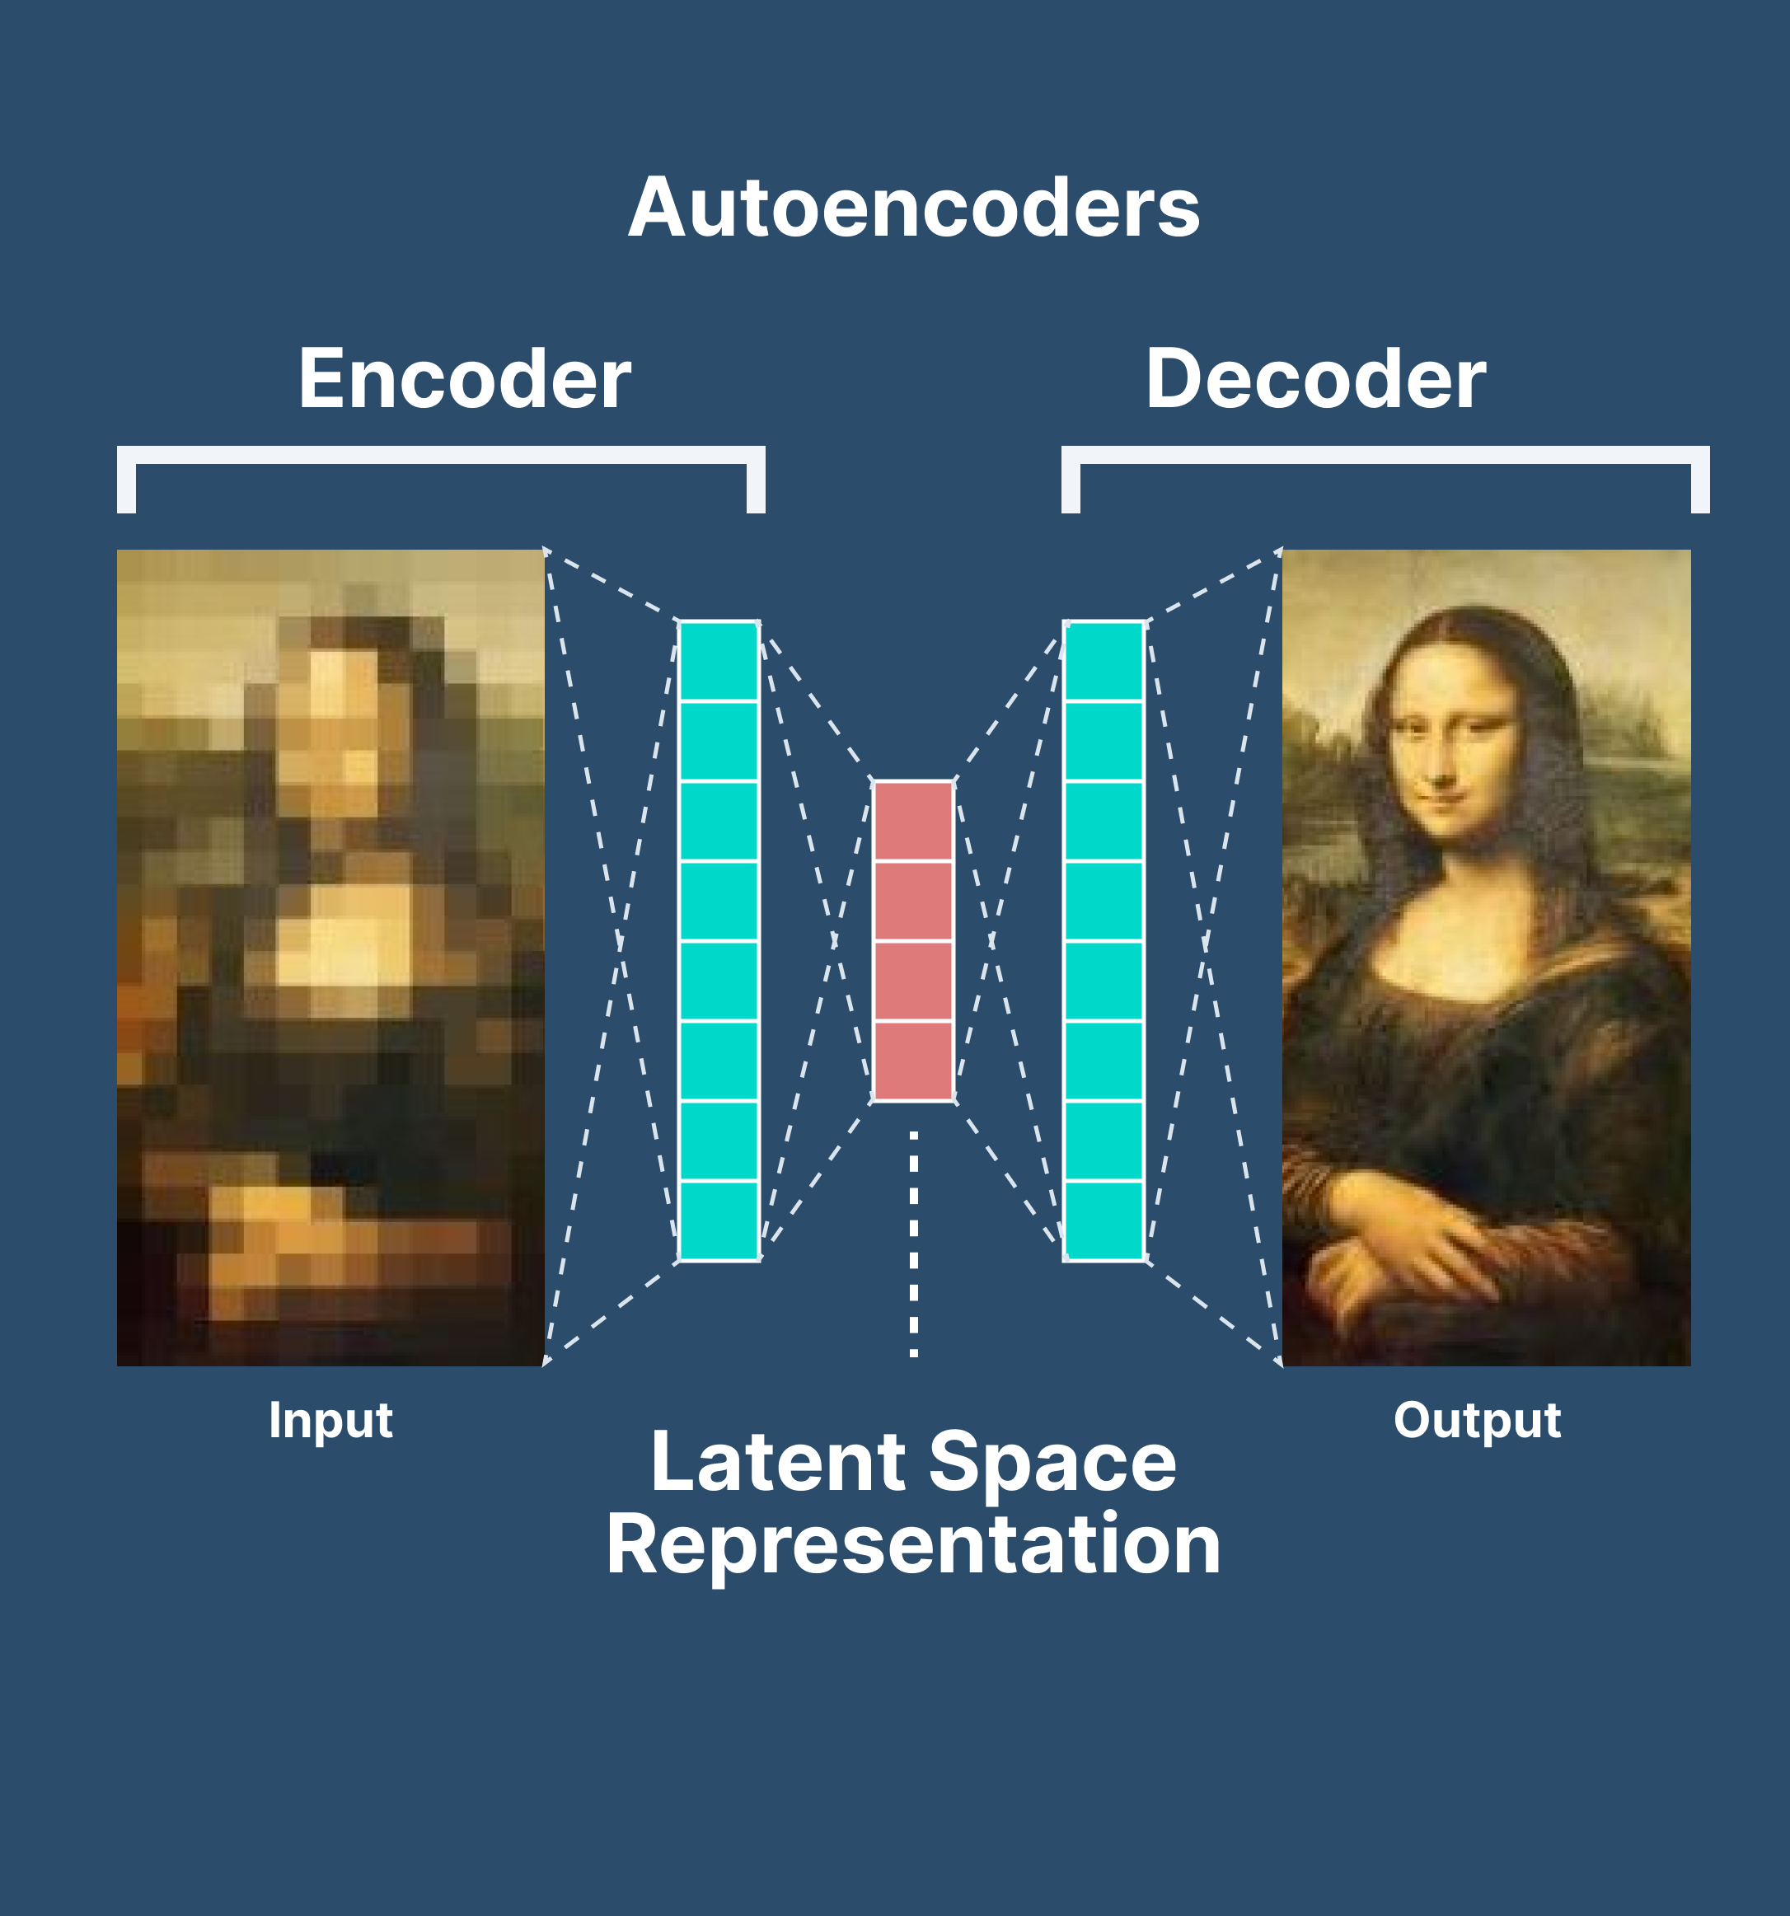
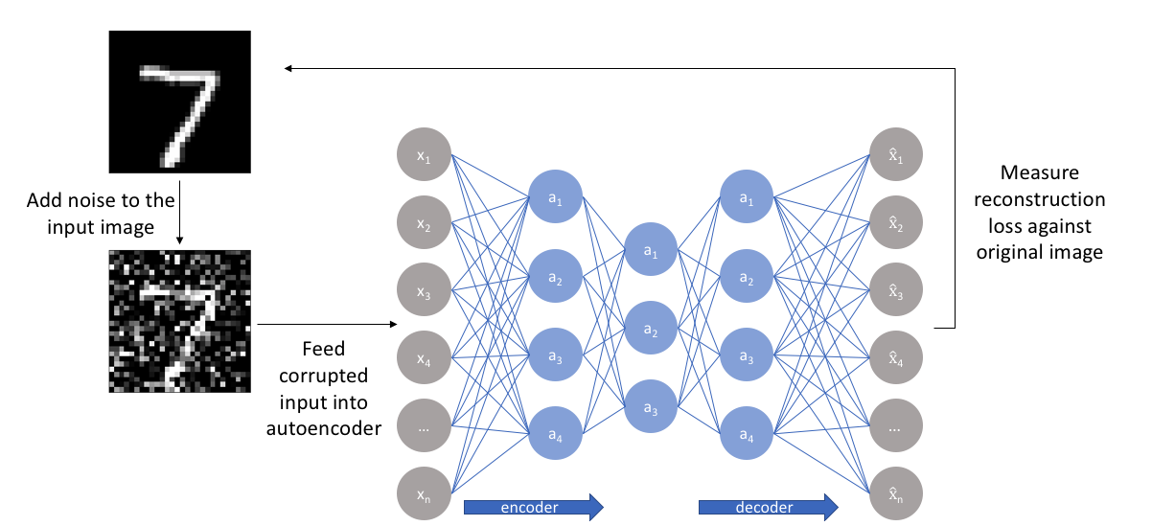

Slide 26
Auto-Encoder
As the compressed representation is dimensionally smaller than the input, the network must attempt to find a smaller representation of the image that allows the image to be best recreated
Autoencoders are an example of lossy compression
Autoencoders are often used to reduce the dimensionality of large datasets to make them easier to use (e.g. for machine learning techniques)
For example, autoencoders have been applied to allow for more efficient representations of chess boards

Slide 27
Auto-Encoders
Training of auto-encoders is expensive
The problem with auto-encoders is choosing the correct network layout (and other relevant supervised learning hyperparameters) to maximise compression, reconstruction accuracy and to minimise compute time
This is often very difficult and time consuming

Slide 28
Auto-Encoders
I’ve trained my own autoencoder using TensorFlow
This autoencoder takes in a 784 pixel image of a clothing item. This is then compressed to 64 pixels using the auto-encoder
First, lets discuss the encoder. The encoder must take a 784 pixel input and convert it to a 64 value output. To achieve this, I have used no hidden layers (to maximise speed)
The output layer contains 64 neurons.
I have chosen to use the sigmoid activation
For the decoder network, we must convert 64 values into 784 values
I have once more elected to use no hidden layers to speed up computation
Let’s look at code! https://github.com/philipmortimer/AI-Course/blob/main/Programs/Part%206/autoencoder/main.py

Slide 29
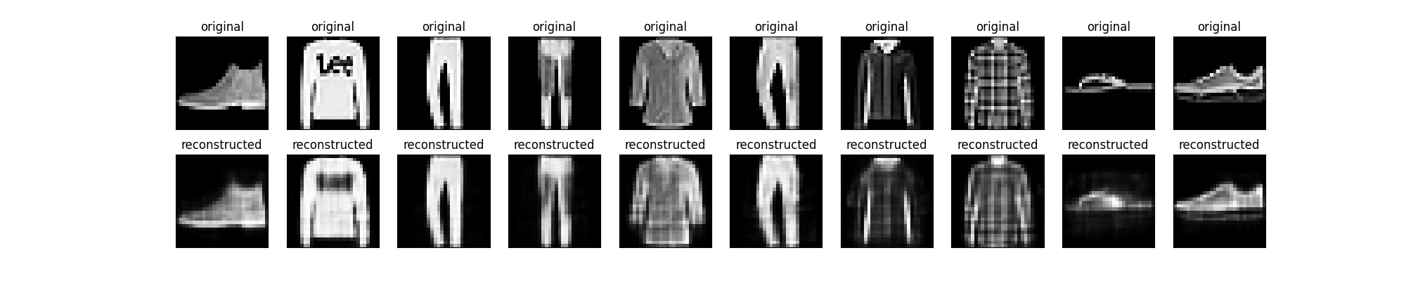
Auto-Encoders

Slide 30
Auto-Encoders
Next, let’s attempt to train an auto-encoder that removes noise from images
To do this, we programmatically generate “noise” which has the effect of blurring our images somewhat
We want to take this blurred image as input and return the unblurred image
This is often used for post-processing of photos
Additionally, it is used to increase the dataset size for traditional compression based autoencoders

Slide 31

Noisy Images

Slide 32
De-Noising Autoencoder
Notice, how we are mimicking supervised learning techniques.
This system is unsupervised however, as it is using unlabelled data as both input and output
For our de-noising autoencoder, I have decided to use convolutional layers in order to enable effective feature extraction
Typically, convolutional approaches are more versatile and effective than just using ANN’s
Let’s look at code! https://github.com/philipmortimer/AI-Course/blob/main/Programs/Part%206/autoencoder/denoiseAutencoder.py

Slide 33
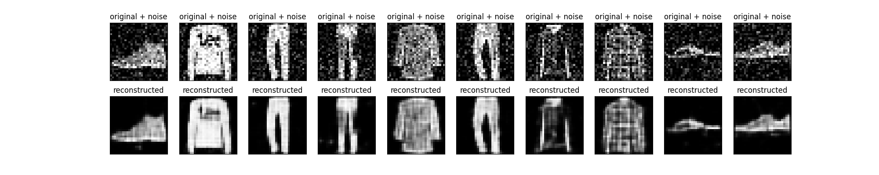
De-Noised Images

Slide 34
Principal Component Analysis (PCA)
Principal component analysis (PCA) is another technique commonly used for dimension reduction
Let’s say we have a database containing millions of entries
Each record stores three data attributes: x, y and z.
Thus, each record is three dimensional
PCA allows us to compress this dataset to 1d, 2d or 3d
It does this by exploiting relationships between x, y and z.
If it turns out that x = 0.5y + 2z, then we can reduce dimensionality as we clearly don’t actually need to store x. It can simply be calculated from y and z.

Slide 35
PCA
Before, doing anything else, it is very important that we standardise all of our attributes so that they have the same range
This is important as PCA essentially captures maximum variance
If one variable has range [0, 255] whilst another has [0, 1], the first variable will typically produce a much larger variance. This is misleading and hence both would need to be altered to fit same range (e.g. [0, 1])

Slide 36

PCA
Say we have records with n variables. This data is said to be n-dimensional
We can then compute the covariance matrix for all possible combination of variable pairs.
If the covariance is positive, it suggests that as one variable, increases, so does the other
Similarly, if it’s negative, it suggests that they are inversely correlated
Small covariances suggest minimal correlation
Covariance matrix for 3d data

Slide 37
PCA
The idea of PCA is to convert n variables into k variables where k <= n
To do this we will create k principal components. The idea is that we fit the most amount of information possible into the first principal component. Then as much into the second component and so on
This allows us to use the first k principal components and ignore the rest, as these first k components will encode the most information

Slide 38
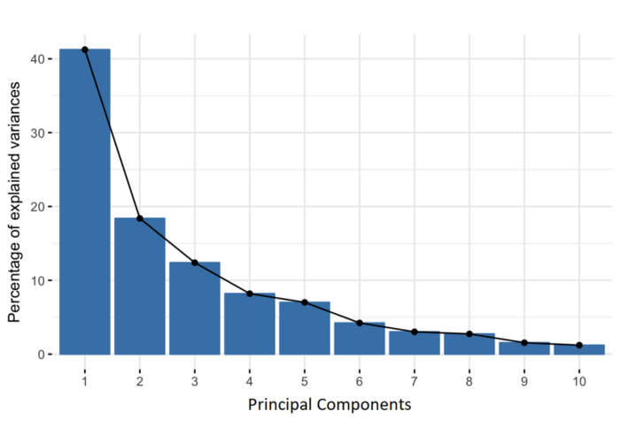
PCA
This is an example for data which has 10 attributes
One principal component attribute (which we must calculate) can explain about 40% of the data variance
Credit: https://builtin.com/data-science/step-step-explanation-principal-component-analysis

Slide 39
PCA
If we calculate all of the eigenvectors of our covariance matrix(and normalise them where we needed), we get a set of vectors
These vectors form an orthonormal basis
Additionally, the corresponding eigenvalues indicate order of importance of each eigenvector (/principal component).
This allows us to rank each principal component as seen on the previous page
You don’t have to understand the maths behind this, just that it allows us to effectively reduce dimensionality
We can select the number of dimensions / accuracy we want
It’s important to note that the principal components lack interpretability

Slide 40
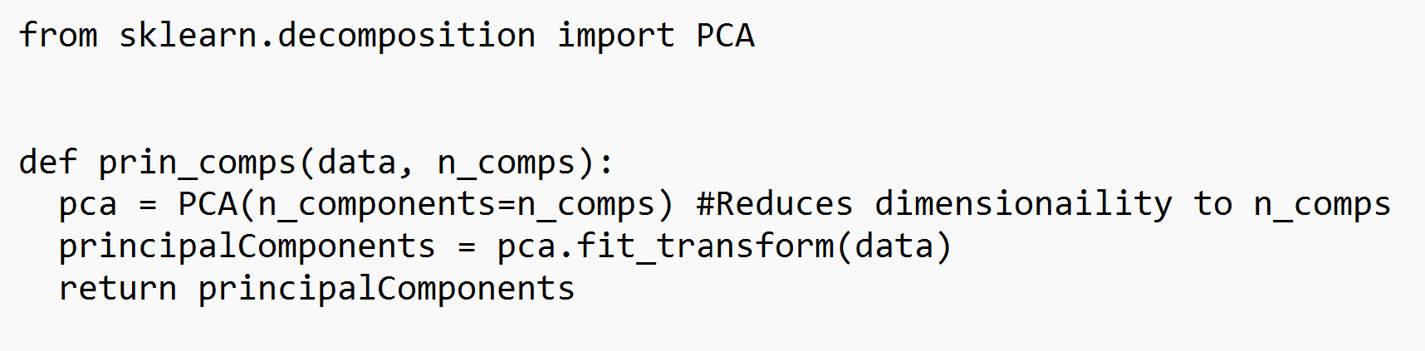
PCA

Slide 41
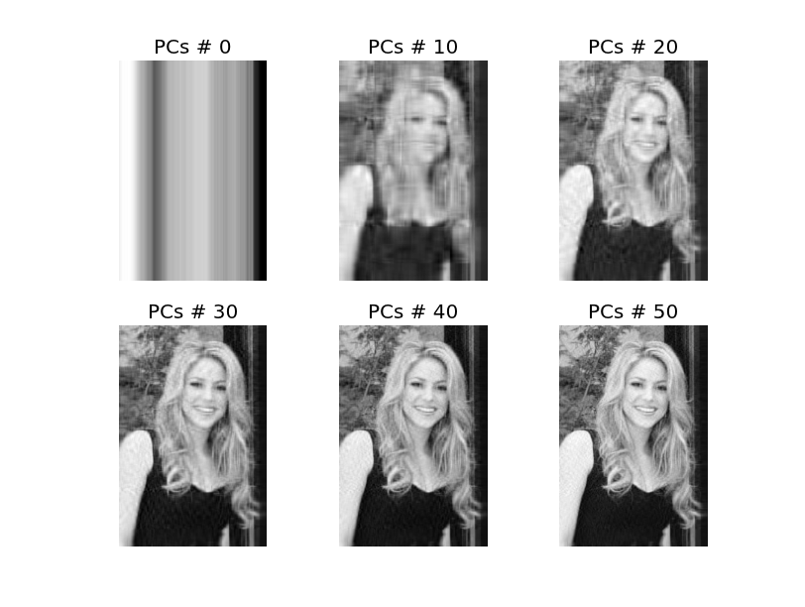

Slide 42
Summary
Unsupervised learning is a machine learning technique applied to datasets which are unlabelled
There are a very wide range of algorithms used in unsupervised learning
K-means clustering focuses on grouping datapoints into a certain number of groups. These clusters will group datapoints that are most similar to them
Similarity between datapoints is calculated via the Euclidian distance in the vector space formed by the attributes of the points
Autoencoders are often used to reduce dimensionality of data
Autoencoders consist of an encoder neural network and a decoder neural network

Slide 43
Summary
The encoder network reduces the dimensionality of the network to a compressed format
The decoder network takes this compressed format and attempts to convert it back to the original datapoint
This can often be thought of as a feature extraction network
Principal Component Analysis (PCA) is another dimensionality reduction technique
The idea is that data may consists of n attributes. In the case of an image, this may mean n pixels
PCA uses complicated maths to create an orthonormal basis with n attributes.

Slide 44
Summary
PCA essentially converts a data item of n attributes and calculates n different attributes to use.
As much information as possible is put into the first attribute. As much information as possible is put into the second attribute
This allows us to reduce the dimensionality of data by dropping as many of the least important attributes as we wish
We can balance the accuracy of the compression with the reduction in data size as we choose
There are many other useful unsupervised techniques

Slide 45

Questions

Slide 46
Further Reading
K-means clustering: https://www.analyticsvidhya.com/blog/2019/08/comprehensive-guide-k-means-clustering/
Autoencoder: https://www.jeremyjordan.me/autoencoders/ https://www.v7labs.com/blog/autoencoders-guide
Principal Component Analysis (PCA): https://builtin.com/data-science/step-step-explanation-principal-component-analysis

